Slide 1

Bible Study
“A Season of Prayer”
Pastor Andrew Barbour
Motto: Proverbs 4:7
Wisdom is the principal thing; therefore get wisdom: and with all thy getting get understanding.
November 18, 2015

Slide 2
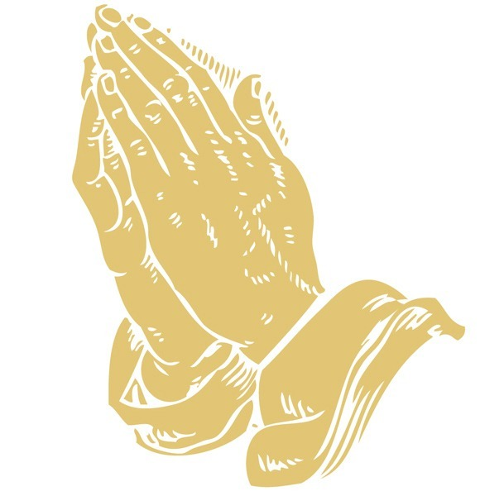
Continuous
Fervent
Prayer!

Slide 3

James 5:16
Confess your faults one to another, and pray one for another, that ye may be healed. The effectual fervent prayer of a righteous man availeth much.

Slide 4
Acts 12: 1-17
Let’s begin with …
ACTS CHAPTER 12: 1-3
1 Now about that time Herod the king stretched forth his hands to vex certain of the church.
2 And he killed James the brother of John with the sword.
3 And because he saw it pleased the Jews, he proceeded further to take Peter also. (Then were the days of unleavened bread.)

Slide 5
Acts 12: 4-6
4 And when he had apprehended him, he put him in prison, and delivered him to four quaternions of soldiers to keep him; intending after Easter to bring him forth to the people.
5 Peter therefore was kept in prison: but prayer was made without ceasing of the church unto God for him.
6 And when Herod would have brought him forth, the same night Peter was sleeping between two soldiers, bound with two chains: and the keepers before the door kept the prison.

Slide 6
Acts 12: 7-9
7 And, behold, the angel of the Lord came upon him, and a light shined in the prison: and he smote Peter on the side, and raised him up, saying, Arise up quickly. And his chains fell off from his hands.
8 And the angel said unto him, Gird thyself, and bind on thy sandals. And so he did. And he saith unto him, Cast thy garment about thee, and follow me.
9 And he went out, and followed him; and wist not that it was true which was done by the angel; but thought he saw a vision.

Slide 7
Acts 12: 10-12
10 When they were past the first and the second ward, they came unto the iron gate that leadeth unto the city; which opened to them of his own accord: and they went out, and passed on through one street; and forthwith the angel departed from him.
11 And when Peter was come to himself, he said, Now I know of a surety, that the Lord hath sent his angel, and hath delivered me out of the hand of Herod, and from all the expectation of the people of the Jews.
12 And when he had considered the thing, he came to the house of Mary the mother of John, whose surname was Mark; where many were gathered together praying.

Slide 8
Acts 12: 13-15
13 And as Peter knocked at the door of the gate, a damsel came to hearken, named Rhoda.
14 And when she knew Peter's voice, she opened not the gate for gladness, but ran in, and told how Peter stood before the gate.
15 And they said unto her, Thou art mad. But she constantly affirmed that it was even so. Then said they, It is his angel.

Slide 9
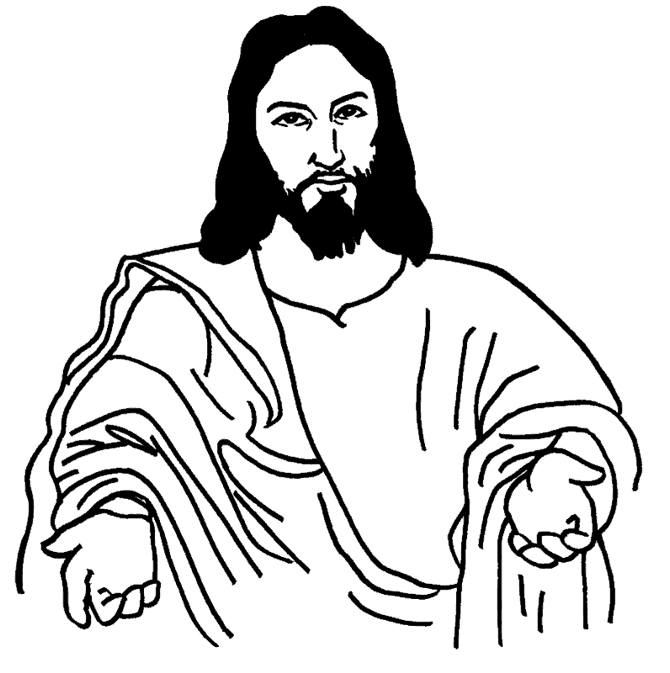
Acts 12: 16-17
16 But Peter continued knocking: and when they had opened the door, and saw him, they were astonished.
17 But he, beckoning unto them with the hand to hold their peace, declared unto them how the Lord had brought him out of the prison. And he said, Go shew these things unto James, and to the brethren. And he departed, and went into another place.

Slide 10
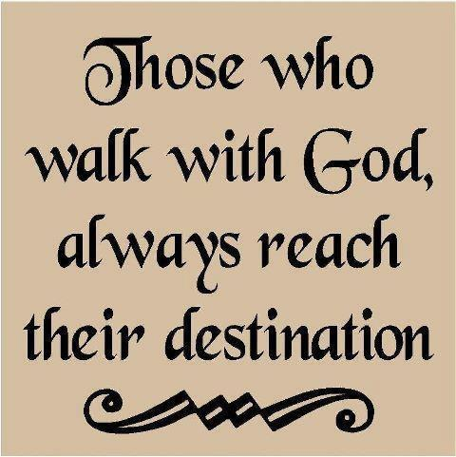
Continue in Fervent Prayer…

